Slide 1

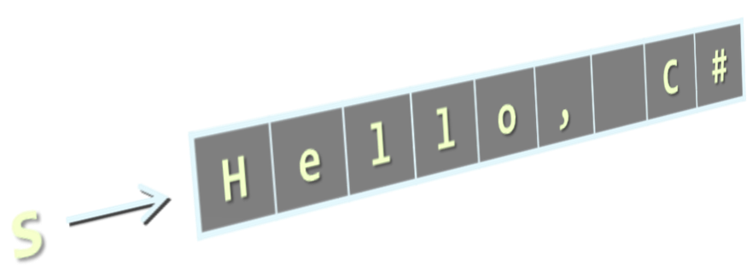



Strings, Regular Expressions and Text Processing
Processing and Manipulating Text Using Strings and Regular Expressions
Programming Fundamentals
SoftUni Team
Technical Trainers
Software University
http://softuni.bg

Slide 2



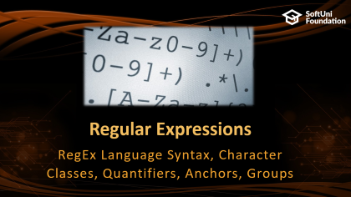
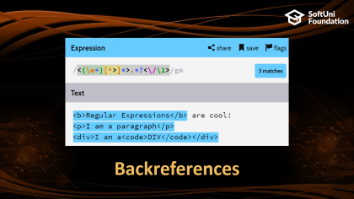

Table of Contents

Slide 3
Have a Question?
sli.do #extended-softuni

Slide 4

Strings
What is a String?

Slide 5

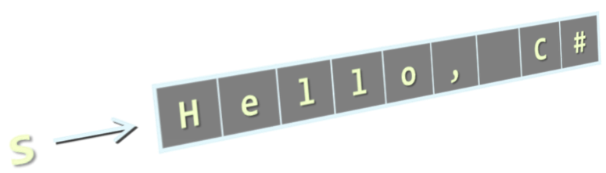
Strings
Strings are sequences of characters (texts)
Strings are immutable (read-only) sequences of characters
Strings are enclosed in quotes:
Concatenated using the "+" operator:
string s = "Hello, C#";
string
string s = "Hello" + " " + "C#";

Slide 6
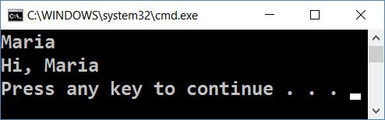
Initializing a String
Initializing from a string literal:
Reading a string from the console:
Converting a string from and to a char array:
0 | 1 | 2 | 3 | 4 | 5 | 6 | 7 | 8
H | e | l | l | o | , |  | C | #
string str = "Hello, C#";
string name = Console.ReadLine();
Console.WriteLine("Hi, " + name);
string str = new String(new char[] {'s', 't', 'r'});
char[] charArr = str.ToCharArray(); // ['s', 't', 'r']

Slide 7


Manipulating Strings
string
Comparing, Concatenating, Searching, Extracting Substrings, Splitting

Slide 8

Comparing Strings
Ordinal (exact binary) string comparison
Case-insensitive string comparison
Case-sensitive string comparison
int eq = (str1 == str2); // uses String.Equals(…)
int result = string.Compare(str1, str2, true);
// result == 0 if str1 equals str2
// result < 0 if str1 is before str2
// result > 0 if str1 is after str2
int result = string.Compare(str1, str2, false);

Slide 9

Concatenating (Combining) Strings
Use the Concat() method
Use the + or the += operators
Any object can be appended to a string
string str = string.Concat(str1, str2);
string str = str1 + str2 + str3;
string str += str1;
string name = "Peter"; int age = 22;
string s = name + " " + age; // → "Peter 22"

Slide 10

Searching in Strings
Finding a substring within a given string
str.IndexOf(string term) – returns the first index or -1
str.LastIndexOf(string term) – finds the last occurence
string email = "vasko@gmail.org";
int firstIndex = email.IndexOf("@"); // 5
int secondIndex = email.IndexOf("a", 2); // 8
int notFound = email.IndexOf("/"); // -1
string verse = "To be or not to be…";
int lastIndex = verse.LastIndexOf("be"); // 16

Slide 11
Problem: Count Substring Occurrences
You are given a text and a pattern
Find how many times that pattern occurs in the text
Overlapping is allowed
ababa caba
aba
3
aaaaaa
aa
5
Welcome to SoftUni
Java
0
Check your solution here: https://judge.softuni.bg/Contests/Practice/Index/854#1

Slide 12
Solution: Count Substring Occurrences
string input = Console.ReadLine().ToLower();
string pattern = Console.ReadLine().ToLower();
int counter = 0;
int index = input.IndexOf(pattern);
while (index != -1)
{
counter++;
index = input.IndexOf(pattern, index + 1)
}
Console.WriteLine(counter);

Slide 13

Extracting Substrings
str.Substring(int startIndex, int length)
str.Substring(int startIndex)
string filename = @"C:\Pics\Rila2017.jpg";
string name = filename.Substring(8, 8);
// name == "Rila2017"
string filename = @"C:\Pics\Rila2017.jpg";
string nameAndExtension = filename.Substring(8);
// nameAndExtension == "Rila2017.jpg"
0 | 1 | 2 | 3 | 4 | 5 | 6 | 7 | 8 | 9 | 10 | 11 | 12 | 13 | 14 | 15 | 16 | 17 | 18 | 19
C | : | \ | P | i | c | s | \ | R | i | l | a | 2 | 0 | 1 | 7 | . | j | p | g

Slide 14

Splitting Strings
Split a string by given separator(s) :
Example:
string[] Split(params char[] separator)
string listOfBeers = "Amstel, Zagorka, Tuborg, Becks.";
string[] beers = listOfBeers.Split(' ', ',', '.');
Console.WriteLine("Available beers are:");
foreach (string beer in beers)
Console.WriteLine(beer);

Slide 15

Other String Operations
Replacing and Deleting Substrings, Changing Character Casing, Trimming

Slide 16


Replacing and Deleting Substrings
str.Replace(match, replacement) – replaces all occurrences
The result is a new string (strings are immutable)
str.Remove(int index, int length) – deletes part of a string
Produces a new string as result
string cocktail = "Vodka + Martini + Cherry";
string replaced = cocktail.Replace("+", "and");
// Vodka and Martini and Cherry
string price = "$ 1234567";
string lowPrice = price.Remove(2, 3);
// $ 4567

Slide 17
Problem: Text Filter (Banned Words)
You are given a text and a string of banned words
Replace all banned words in the text with asterisks
Replace with asterisks (*), whose count is equal to the word's length
Linux, Windows
It is not Linux, it is GNU/Linux. Linux is merely the kernel, while GNU adds the functionality...
It is not *****, it is GNU/*****. ***** is merely the kernel, while GNU adds the functionality...
Check your solution here: https://judge.softuni.bg/Contests/Practice/Index/854#2

Slide 18
Solution: Text Filter
string[] banWords = Console.ReadLine()
.Split(…); // TODO: add separators
string text = Console.ReadLine();
foreach (var banWord in banWords)
{
if (text.Contains(banWord))
{
text = text.Replace(banWord,
new string('*', banWord.Length));
}
}
Console.WriteLine(text);
Contains(…) checks if string contains another string
Replace a word with a sequence of asterisks of the same length

Slide 19

Changing Character Casing
Using the method ToLower()
Using the method ToUpper()
string alpha = "aBcDeFg";
string lowerAlpha = alpha.ToLower(); // abcdefg
Console.WriteLine(lowerAlpha);
string alpha = "aBcDeFg";
string upperAlpha = alpha.ToUpper(); // ABCDEFG
Console.WriteLine(upperAlpha);

Slide 20

Trimming White Space
str.Trim() – trims whitespaces at start and end of string
str.Trim(params char[] chars)
str.TrimStart() and str.TrimEnd()
string s = " example of white space ";
string clean = s.Trim();
Console.WriteLine(clean); // example of white space
string s = " \t\nHello!!! \n";
string clean = s.Trim(' ', ',' ,'!', '\n','\t');
Console.WriteLine(clean); // Hello
string s = " C# ";
string clean = s.TrimStart(); // clean = "C# "

Slide 21

String Operations
Live Exercises in Class (Lab)

Slide 22

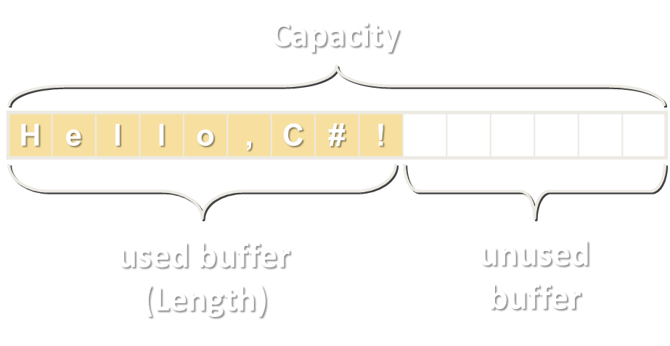
Building and Modifying Strings
Using the StringBuilder Class

Slide 23
StringBuilder: How It Works?
Capacity
StringBuilder:
Length = 9
Capacity = 15
H | e | l | l | o | , | C | # | !
used buffer
(Length)
unused buffer
StringBuilder keeps a buffer space, allocated in advance
Do not allocate memory for most operations → performance

Slide 24
Changing the Contents of a String
Use the System.Text.StringBuilder to build / modify strings:
public static string ReverseString(string str)
{
StringBuilder sb = new StringBuilder();
for (int i = str.Length - 1; i >= 0; i--)
{
sb.Append(str[i]);
}
return sb.ToString();
}
Notes:
Introducing the StringBuffer Class
StringBuffer represents strings that can be modified and extended at run time. The following example creates three new String objects, and copies all the characters each time a new String is created:
String quote = "Fasten your seatbelts, ";
quote = quote + "it's going to be a bumpy night.";
It is more efficient to preallocate the amount of space required using the StringBuffer constructor, and its append() method as follows:
StringBuffer quote = new StringBuffer(60); // allocate 60 chars
quote.append("Fasten your seatbelts, "); quote.append(" it's going to be a bumpy night. ");
StringBuffer also provides a number of overloaded insert() methods for inserting various types of data at a particular location in the string buffer.
Instructor Note
The example in the slide uses StringBuffer to reverse the characters in a string. A StringBuffer object is created, with the same length as the string. The loop traverses the String parameter in reverse order and appends each of its characters to the StringBuffer object by using append(). The StringBuffer therefore holds a reverse copy of the String parameter. At the end of the method, a new String object is created from the StringBuffer object, and this String is returned from the method.

Slide 25
The StringBuilder Class
StringBuilder(int capacity) constructor allocates in advance buffer of size capacity
Capacity holds the currently allocated space (in characters)
Length holds the length of the string in the buffer
this[int index] (indexer) access the char at given position
Capacity
H | e | l | l | o | , | C | # | !
used buffer (Length)
unused buffer

Slide 26
StringBuilder Operations – Examples
var builder = new StringBuilder(100);
builder.Append("Hello Maria, how are you?");
Console.WriteLine(builder); // Hello Maria, how are you?
builder[6] = 'D';
Console.WriteLine(builder); // Hello Daria, how are you?
builder.Remove(5, 6);
Console.WriteLine(builder); // Hello, how are you?
builder.Insert(5, " Peter");
Console.WriteLine(builder); // Hello Peter, how are you?
builder.Replace("Peter", "George");
Console.WriteLine(builder); // Hello George, how are you?

Slide 27
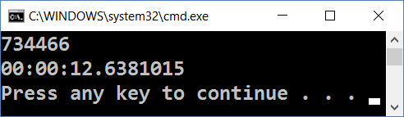
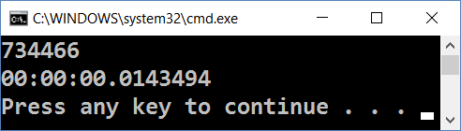
Problem: String Concatenation
Given the code below try to optimize it to go under a second
Do not change the loop or the Convert.ToString() method
var timer = new Stopwatch();
timer.Start();
string result = "";
for (int i = 0; i < 50000; i++)
result += Convert.ToString(i, 2);
Console.WriteLine(result.Length);
Console.WriteLine(timer.Elapsed);

Slide 28
Solution: String Concatenation
var timer = new Stopwatch();
timer.Start();
var result = new StringBuilder();
for (int i = 0; i < 50000; i++)
result.Append(Convert.ToString(i, 2));
Console.WriteLine(result.Length);
Console.WriteLine(timer.Elapsed);

Slide 29
Regular Expressions
RegEx Language Syntax, Character Classes, Quantifiers, Anchors, Groups

Slide 30

What are Regular Expressions?
Regular expressions (regex)
Match text by pattern
Patterns are defined by special syntax, e.g.
[0-9]+ matches non-empty sequence of digits
[A-Z][a-z]* matches a capital + small letters
\s+ matches whitespace (non-empty)
\S+ matches non-whitespace
Play with regex live at: regexr.com, regex101.com, regextester.com

Slide 31
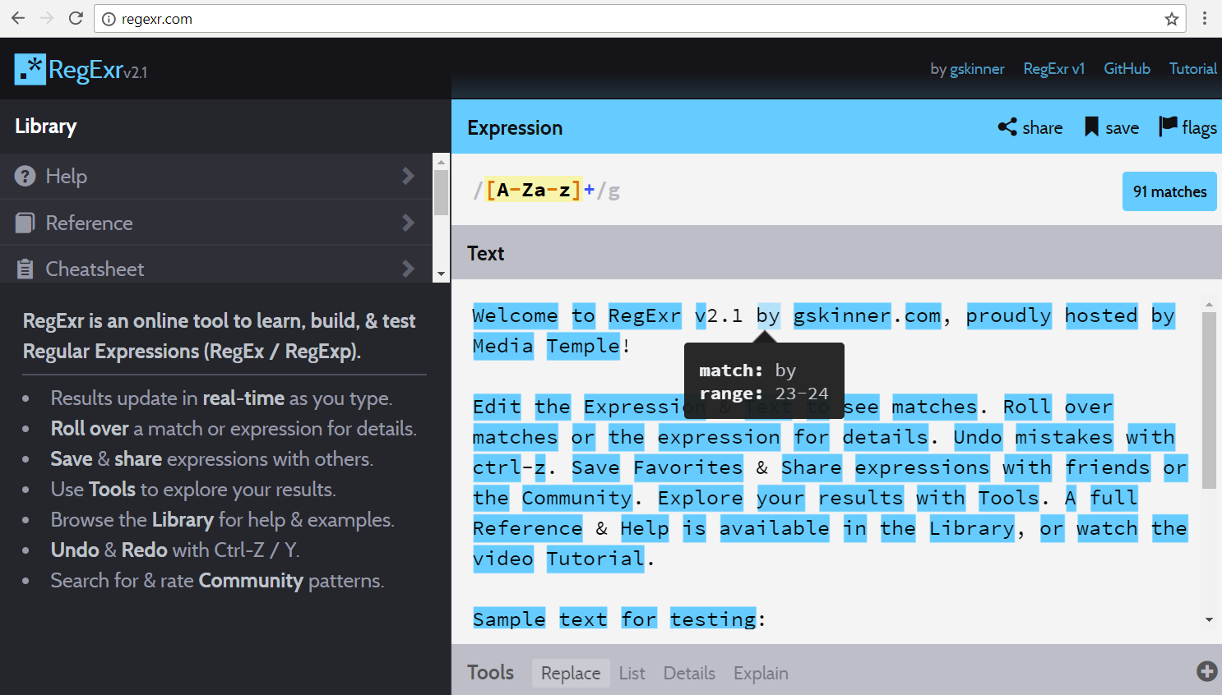
Playing with regexr.com
Live Demo

Slide 32
Regular Expression Pattern – Example
Regular expressions (regex) describe a search pattern
Used to find / extract / replace / split data from text by pattern
[A-Z][a-z]+ [A-Z][a-z]+ - \w+@\w+\.\w+
matches
Ivan Ivanov - ivan@gmail.com
Petar Iotov - petar@abv.bg
Contact: Alex Georgiev - alex@mail.com …
Test your regex here: http://regexr.com/3g8gc

Slide 33
Character Classes: Ranges
[nvj] matches any character that is either n, v or j
[^abc] – matches any character that is not a, b or c
[0-9] – character range: matches any digit from 0 to 9
node.js v0.12.2
Abraham Lincoln
In 1519 Leonardo da Vinci died at the age of 67.

Slide 34
Character Classes: Predefined
\w – matches any word character (a-z, A-Z, 0-9, _)
\W – matches any non-word character (the opposite of \w)
\s – matches any white-space character
\S – matches any non-white-space character (opposite of \s)
\d – matches any decimal digit
\D – matches any non-decimal digit (opposite of \d)
aBcd 09_ &*^
aBcd 09_ &*^
Notes:
\w – Matches any word character (a-z, A-Z, 0-9, _)
\W – Matches any non-word character (the opposite of \w)
\s – Matches any white-space character
\S – Matches any non-white-space character (opposite of \s)
\d – Matches any decimal digit
\D – Matches any non-digit character (opposite of \d)

Slide 35
Quantifiers
* – matches the previous element zero or more times
+ – matches the previous element one or more times
? – matches the previous element zero or one time
{3} – matches the previous element exactly 3 times
\+\d*
+359885976002 a+b
\+\d+
+359885976002 a+b
\+\d?
+359885976002 a+b
\+\d{3}
+359885976002 a+b

Slide 36
Character Escapes
Sometimes we need to look for special characters like new lines, tabs, dots, slashes, brackets, etc.
Use character escaping in the RegEx like this:
This is a “tab”
A new line comes at the end
Name: Peter
Phone: +359882042353
Name:\t\w+\nPhone:\s*\+\d+

Slide 37

Anchors
^ – the match must start at the beginning of the text or line
$ – the match must occur at the end of the text or line
Example – username validation pattern:
Use multiline matching (/m flag) to match the end of line
^\w{6,12}$
jeff_butt
short
johnny
too_long_username
!lleg@l_ch@rs

Slide 38
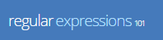

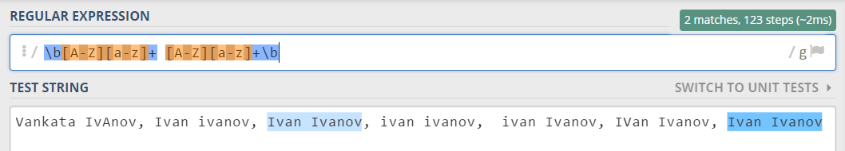
Problem: Match a Full Name
You are given a sequence of words
Find those which are full names
A full name consists of two words (space-separated)
Word are: uppercase latin letter + several lowercase latim letters
Use online regex matcher like RegXr or Regex101
Check your solution here: https://judge.softuni.bg/Contests/Practice/Index/854#4

Slide 39
Grouping Constructs
(subexpression) – captures the matched subexpression as numbered group
(?:subexpression) – defines a non-capturing group
(?<name>subexpression) – defines a named capturing group
\d{2}-(\w{3})-\d{4}
22-Jan-2015
^(?:Hi|hello),\s*(\w+)$
Hi, Peter
(?<day>\d{2})-(?<month>\w{3})-(?<year>\d{4})
22-Jan-2015

Slide 40
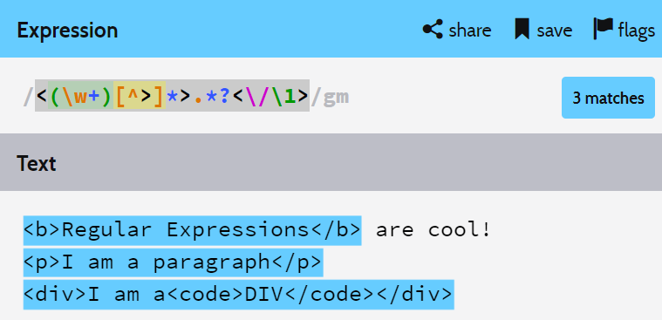
Backreferences

Slide 41
Backreferences Match Previous Groups
\number – matches the value of a numbered capture group
<(\w+)[^>]*>.*?<\/\1>
<b>Regular Expressions</b> are cool!
<p>I am a paragraph</p> … some text after
Hello, <div>I am a<code>DIV</code></div>!

Slide 42
Playing with RegEx
Exercises in Class

Slide 43
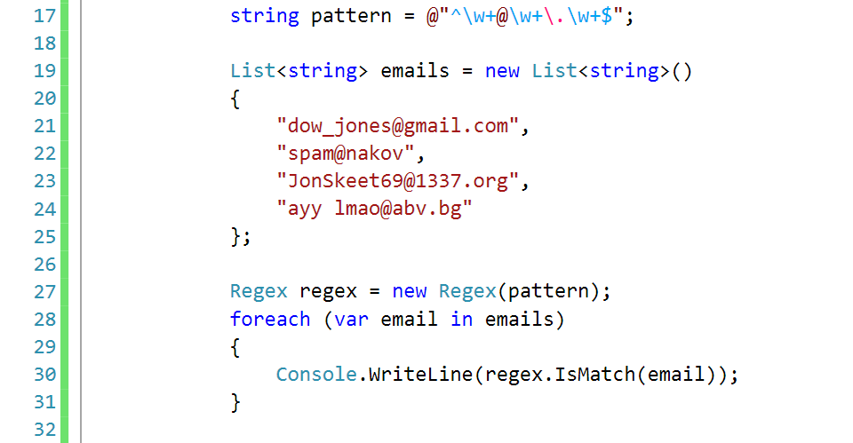
Regular Expressions
Using .NET Built-In Regex Classes

Slide 44
Regex in C#
C# supports a built-in regular expression class: Regex
Located in System.Text.RegularExpressions namespace
using System.Text.RegularExpressions;
static void Main()
{
string pattern = @"A\w+";
Regex regex = new Regex(pattern);
}

Slide 45
Validating String By Pattern
IsMatch(string text)
Determines whether the text matches given pattern
string text = "Today is 2015-05-11";
string pattern = @"\d{4}-\d{2}-\d{2}";
Regex regex = new Regex(pattern);
bool containsValidDate = regex.IsMatch(text);
Console.WriteLine(containsValidDate); // True

Slide 46
Checking for a Single Match
Match(string text)
Рeturns the first match of given pattern
string text = "Nakov: 123";
string pattern = @"([A-Z][a-z]+): (\d+)";
Regex regex = new Regex(pattern);
Match match = regex.Match(text);
Console.WriteLine(match.Groups.Count); // 3
Console.WriteLine("Matched text: \"{0}\"", match.Groups[0]);
Console.WriteLine("Name: {0}", match.Groups[1]); // Nakov
Console.WriteLine("Number: {0}", match.Groups[2]); // 123

Slide 47
Checking for Matches
Matches(string text) – returns a collection of matches
string text = "Nakov: 123, Branson: 456";
string pattern = @"([A-Z][a-z]+): (\d+)";
Regex regex = new Regex(pattern);
MatchCollection matches = regex.Matches(text);
Console.WriteLine("Found {0} matches", matches.Count);
foreach (Match match in matches)
Console.WriteLine("Name: {0}", match.Groups[1]);
// Found 2 matches
// Name: Nakov
// Name: Branson

Slide 48
Replacing With Regex
Replace(string text, string replacement) – replaces all strings that match the pattern with the provided replacement
string text = "Nakov: 123, Branson: 456";
string pattern = @"\d{3}";
string replacement = "999";
Regex regex = new Regex(pattern);
string result = regex.Replace(text, replacement);
Console.WriteLine(result);
// Nakov: 999, Branson: 999

Slide 49
Problem: Replace <a> tag
You are given some html text
Replace all <a> tags in it with [URL]
<ul> <li> <a href="http://softuni.bg">SoftUni</a></li></ul>
<ul> <li> [URL href="http://softuni.bg"]SoftUni[/URL]</li></ul>
Check your solution here: https://judge.softuni.bg/Contests/Practice/Index/854#9

Slide 50
Solution: Replace <a> tag
string text = Console.ReadLine();
while (text != "end")
{
string pattern = @"<a.*?href.*?=(.*)>(.*?)<\/a>";
string replacement = @"[URL href=$1]$2[/URL]";
string replaced = Regex.Replace(
text, pattern, replacement);
Console.WriteLine(replaced);
text = Console.ReadLine();
}
Notes:
You can try also: @"<a.*href=((?:.|\n)*?(?=>))>((?:.|\n)*?(?=<))<\/a>"

Slide 51
Splitting With Regex
Split(string text) – splits the text by the pattern
Returns string[]
string text = "1 2 3 4";
string pattern = @"\s+";
string[] results = Regex.Split(text, pattern);
Console.WriteLine(string.Join(", ", results));
// 1, 2, 3, 4

Slide 52
Built-in RegEx .NET API
Exercises in Class

Slide 53


Summary
Strings are immutable sequences of Unicode characters
String processing methods
IndexOf(), Compare(), Substring(), Remove(), ToUpper / ToLower(), Replace(), …
Regular expressions describe patterns for searching through text
Can utilize character classes, groups, quantifiers and more
string str = "Hello, C#";

Slide 54







Progr. Fund. Extended – Strings and Regex
https://softuni.bg/courses/programming-fundamentals

Slide 55
License
This course (slides, examples, demos, videos, homework, etc.) is licensed under the "Creative Commons Attribution-NonCommercial-ShareAlike 4.0 International" license

Slide 56





Trainings @ Software University (SoftUni)
Software University – High-Quality Education, Profession and Job for Software Developers
softuni.bg
Software University Foundation
http://softuni.foundation/
Software University @ Facebook
facebook.com/SoftwareUniversity
Software University Forums
forum.softuni.bg

